Slide 1
CSE 474 Software Design and Architecture
Lecturer Rabia Khan

Slide 2
Design Phase…..
The design phase follows the following path:
  Defining Use Cases (Visual Modeling done by Use Case Diagrams)
  Domain Modeling (Identify Conceptual Classes)
  System Sequence Diagrams (Identify systems events)
  Package Diagrams
  Class Diagrams
  Object Designing (GRASP, GoF)
  Mapping Design to Code
Elaboration (ITERATION 1)

Slide 3
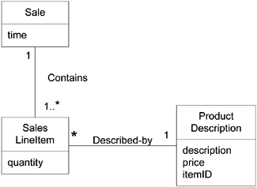
What is Domain Model?
It acts as a source of inspiration for designing some software objects
It is drawn using UML class notation
Significant objects are identified
  In Domain modeling, we omit:
    • software artifacts like windows, databases, …
    • responsibilities or methods
Will be covered in Lab session in detail
Domain Model of a Point of Sale (POS) application

Slide 4
Design Phase…..
The design phase follows the following path:
  Defining Use Cases (Visual Modeling done by Use Case Diagrams)
  Domain Modeling (Identify Conceptual Classes)
  System Sequence Diagrams (Identify systems events)
  Package Diagrams
  Class Diagrams
  Object Designing (GRASP, GoF)
  Mapping Design to Code
Elaboration (ITERATION 1)

Slide 5
Responsibility-Driven Design
A popular way of thinking about the design of software objects and also larger-scale components is in terms of Responsibilities, Roles and Collaborations.
This is part of a larger approach called Responsibility-Driven Design or RDD.

Slide 6

Responsibilities
Responsibilities are assigned to
classes of objects during object design.
Responsibilities are related to the obligations or behavior of an object in terms of its role.
These responsibilities are realized as methods
Basically, these responsibilities are of the following two types:
  Doing
  Knowing

Slide 7

Doing responsibilities
Doing responsibilities of an object include:
  doing something itself, such as creating an object or doing a calculation
  initiating action in other objects
  controlling and coordinating activities in other objects

Slide 8
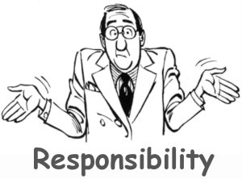
Knowing responsibilities
Knowing responsibilities of an object include:
  knowing about private encapsulated data
  knowing about related objects
  knowing about things it can derive or calculate

Slide 9
How to assign responsibilities ?
Random assignment ?
Based on Past experience (if we have any) ?
Based on already well established principles,
best practices → Patterns
Specific Problem
Common Solution
(Patterns)

Slide 10
What are Patterns?
Experienced OO developers (and other software developers) build up a stock of both general principles and idiomatic solutions that guide them in the creation of software.
These principles and idioms, if codified in a structured format describing the problem and solution and named, may be called patterns.

Slide 11
Patterns
A pattern is a named description of a problem and a solution that can be applied to new contexts; it provides advice in how to apply it in varying circumstances. For example,
Pattern name: Information Expert
Problem: What is the most basic principle by which to assign responsibilities to objects?
Solution: Assign a responsibility to the class that has the information needed to fulfill it.

Slide 12
GRASP (Designing objects with responsibilities)
General Responsibility Assignment Software Patterns.
During design and coding, we apply various OO design principles, among them software design patterns such as GRASP and GoF (Gang of Four) hold extreme importance
They describe the fundamental principles of object design and responsibility assignment, expressed as patterns.
This is a natural result of identifying patterns from practices that have developed over years of experience.

Slide 13
GRASP Patterns
Information Expert
Creator
Controller
Low Coupling
High Cohesion
Polymorphism
Pure Fabrication
Indirection
Don’t Talk to Strangers

Slide 14
Responsibility Assignment
A Design Model may define hundreds or thousands of software classes
An application may require hundreds or thousands of responsibilities to be fulfilled
During object design, when the interactions between objects are defined, we make choices about the assignment of responsibilities to software classes.

Slide 15
Why responsibility assignment?
If chosen well, systems tend to be easier to
  Understand
  Maintain
  Extend
  More opportunity to reuse components in future applications

Slide 16
Information Expert
What is a general principle of assigning responsibilities to objects?
  Assign a responsibility to the information expert - the class that has the information necessary to fulfill the responsibility.

Slide 17
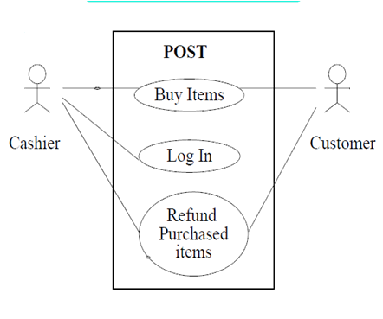
Case Study : Point of Sale (POS) Application
The Point-of-Sale terminal is a computerized system used to record sales and handle payments; it is typically used in a retail store. It includes hardware components such as a computer and bar code scanner, and software to run the system.
The Use Case Diagram
for the POS Application
identifying all actors, use cases,
associations and relationships is shown.

Slide 18
Case Study : Point of Sale (POS) Application
  The “Buy Items” Use Case Description is as follows:
When a Customer arrives at the POS Terminal checkout with items to purchase.
The Cashier records each items. If there is more than one of an item, the Cashier can enter the quantity as well.
The system determines the item price
and adds the item information to running
sales transaction. The description and
price of the current item are presented.
On completion of item entry, the
Cashier indicates to the POS Terminal that
item entry is complete.
The system calculates and presents
the sale total.
The Cashier tells the Customer the total.

Slide 19
Case Study : Point of Sale (POS) Application
In the POS (Point of Sale) application, some class needs to know the grand total of a sale
Responsibility
  Who should be responsible for knowing the grand total of a sale?
By Information Expert, we should look for that class of objects that has the information needed to determine the total.

Slide 20
Identifying Suitable Classes
Do we look in the Domain Model or the Design Model to analyze the classes that have the information needed?
  The Domain Model illustrates conceptual classes of the real-world domain
  The Design Model illustrates software classes.

Slide 21
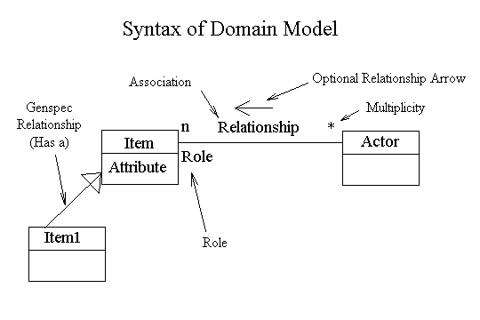
Identifying Suitable Classes
Domain model has the following syntax:
Generally it only consists of the classes and their associations
The attributes show the data part of the class
The methods are not the part of the Domain Model
UML Class Diagram notation is used to express Domain Model

Slide 22
POS Case Study
The Point-of-Sale terminal is a computerized system used to record sales and handle payments; it is typically used in a retail store. Whenever a customer makes a purchase, the quantity of the product is multiplied by the product’s price. The time of this sale is recorded. Sub-totals are calculated to calculated grand-total.

Slide 23
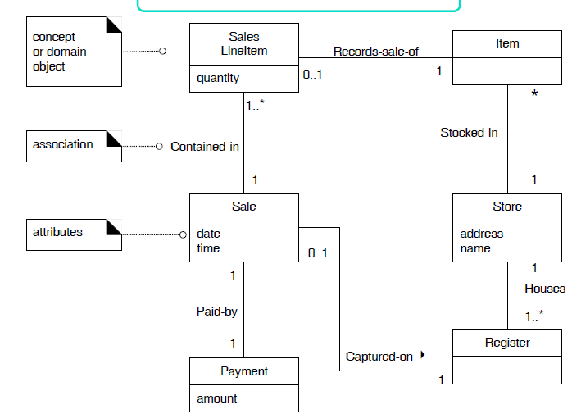

Identifying Suitable Classes – POS Application
Domain Model (uptil now...)

Slide 24
POS Domain Model
What information do we need to determine the grand total?
We need to know about all the SalesLineItem instances of a sale and the sum of their subtotals.
A Sale instance contains SaleLineItems; therefore, by the guideline of Information Expert, Sale is a suitable class of object for this responsibility; it is an information expert for the work.

Slide 25

Information Expert - Example
A partial Class Diagram and Interaction diagram.

Slide 26
Information Expert - Example
What information do we need to determine the line item subtotal?
  SalesLineItem.quantity
  ProductDescription.price
The SalesLineItem knows its quantity and its associated ProductDescription
By Expert, SalesLineItem should determine the subtotal; it is the information expert.

Slide 27
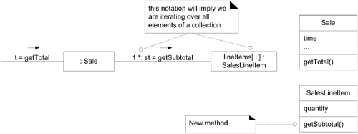

Slide 28
To fulfill the responsibility of knowing and answering its subtotal, a SalesLineItem has to know the product price.
The ProductDescription is an information expert on answering its price; therefore, SalesLineItem sends it a message asking for the product price.

Slide 29
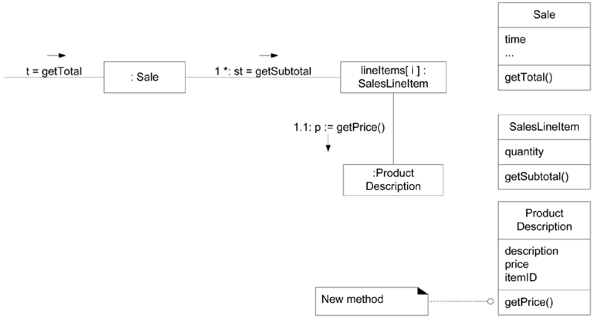

Slide 30
Information Expert
Information Expert is frequently used in the assignment of responsibilities; it is a basic guiding principle used continuously in object design.
Expert is not meant to be an obscure or fancy idea; it expresses the common "intuition" that objects do things related to the information they have.

Slide 31
Information Expert
Notice that the fulfillment of a responsibility often requires information that is spread across different classes of objects.
This implies that many "partial" information experts will collaborate in the task.
For example, the sales total problem ultimately required the collaboration of three classes of objects.
Whenever information is spread across different objects, they will need to interact via messages to share the work.

Slide 32
Suggested Reading
Chapter 17
  Applying UML and Patterns,
  Craig Larman.

